Slide 1
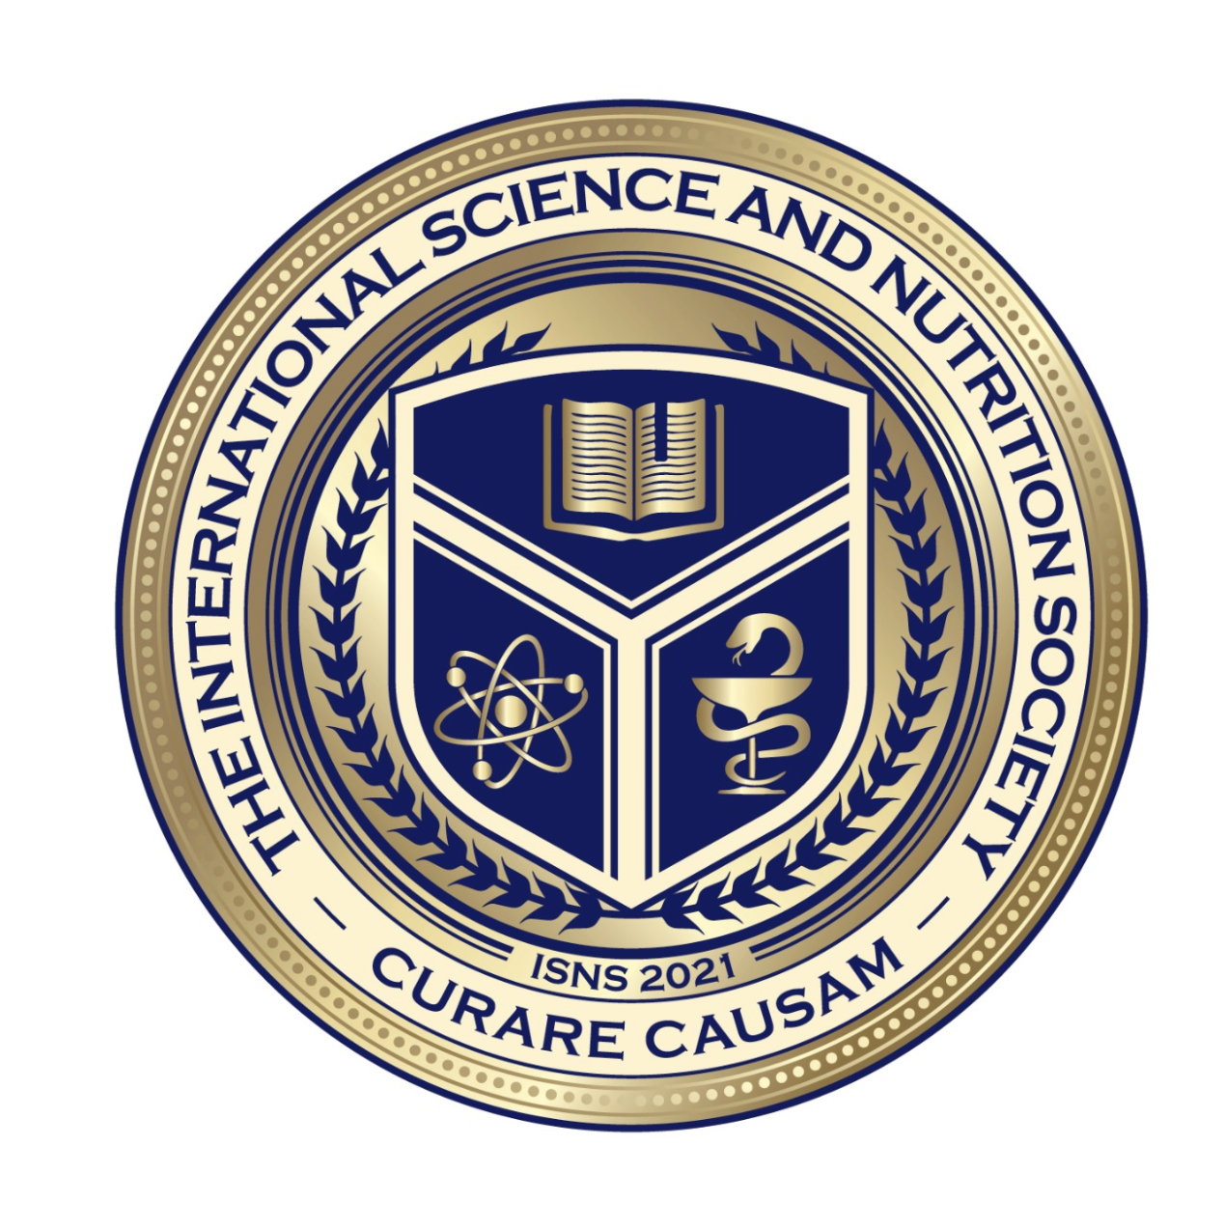
Science with Dr. Christina Rahm We will get started shortly.

Slide 2
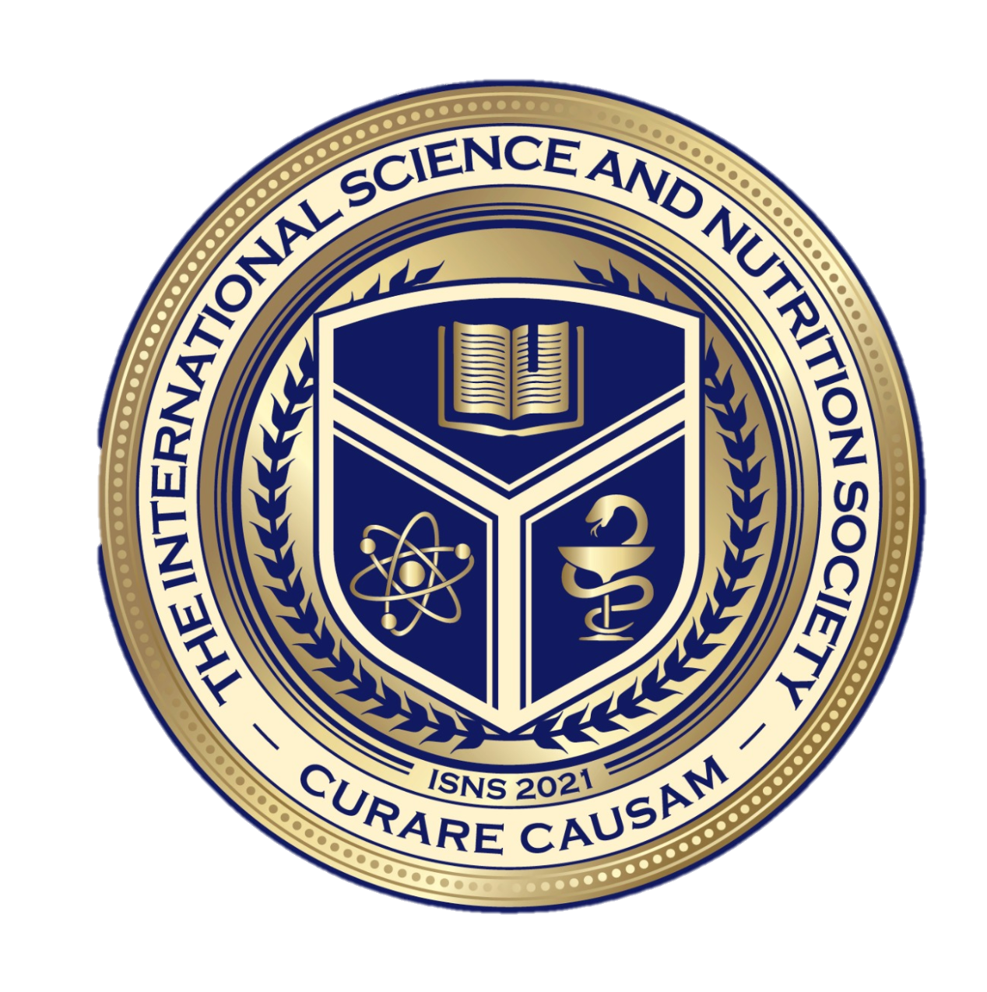
Medical Disclaimer:
The information provided is for educational purposes and is not intended as medical advice, or a substitute for the medical advice of a physician or other qualified health care professional. You should not use this information for diagnosing a health or fitness problem or disease. You should always consult with a doctor or other health care professional for medical advice or information about diagnosis and treatment.
Notes:
The information provided is for educational purposes and is not intended as medical advice, or a substitute for the medical advice of a physician or other qualified health care professional. We do not aim to diagnose, treat, cure or prevent any illness or disease. You should always consult with a doctor or other health care professional for medical advice or information about diagnosis and treatment. The information in this presentation has not been evaluated by the Food & Drug Administration or any other medical body.

Slide 3
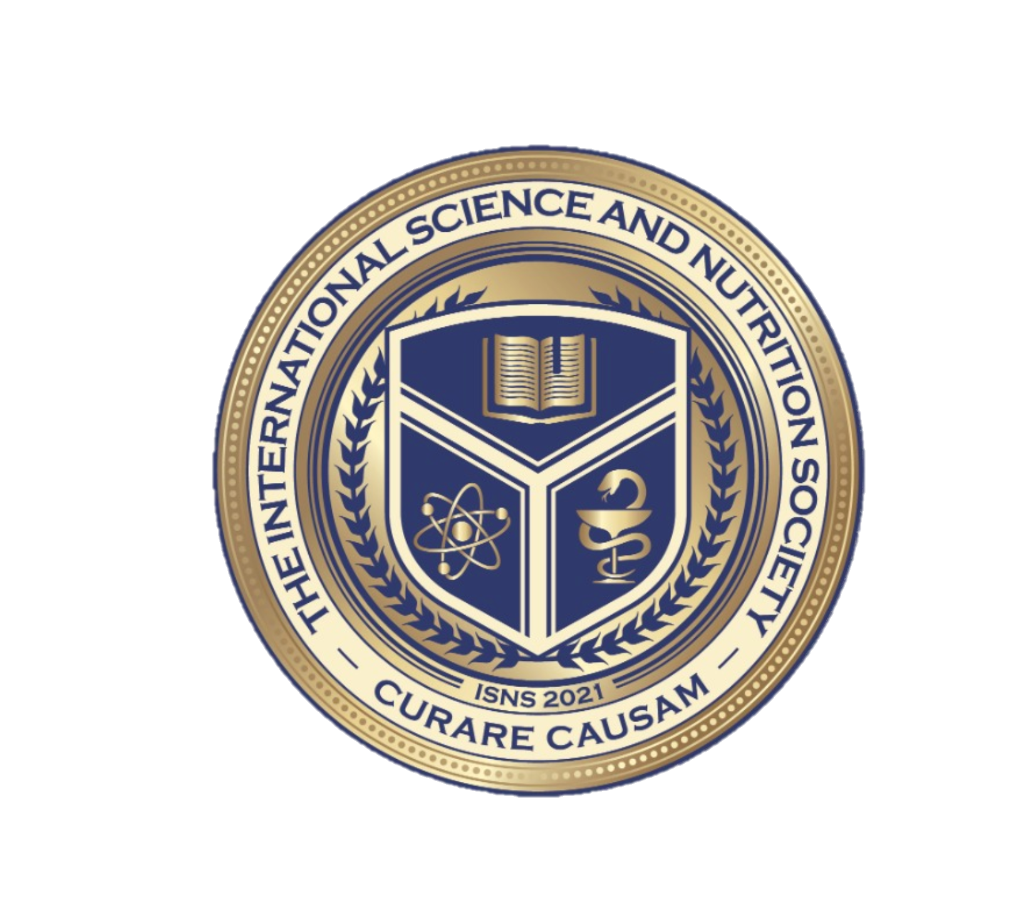
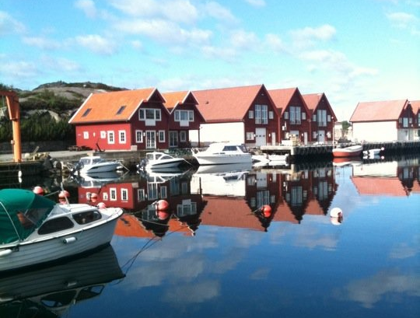
Dr. Dori Naerbo, Ph.D.
Notes:
Good morning, good afternoon, good evening…wherever you are in the world this is Dr. Dori Naerbo and I am your host on today’s call. For those of you who do not know me…I am a clinical researcher and author of several books.

Slide 4
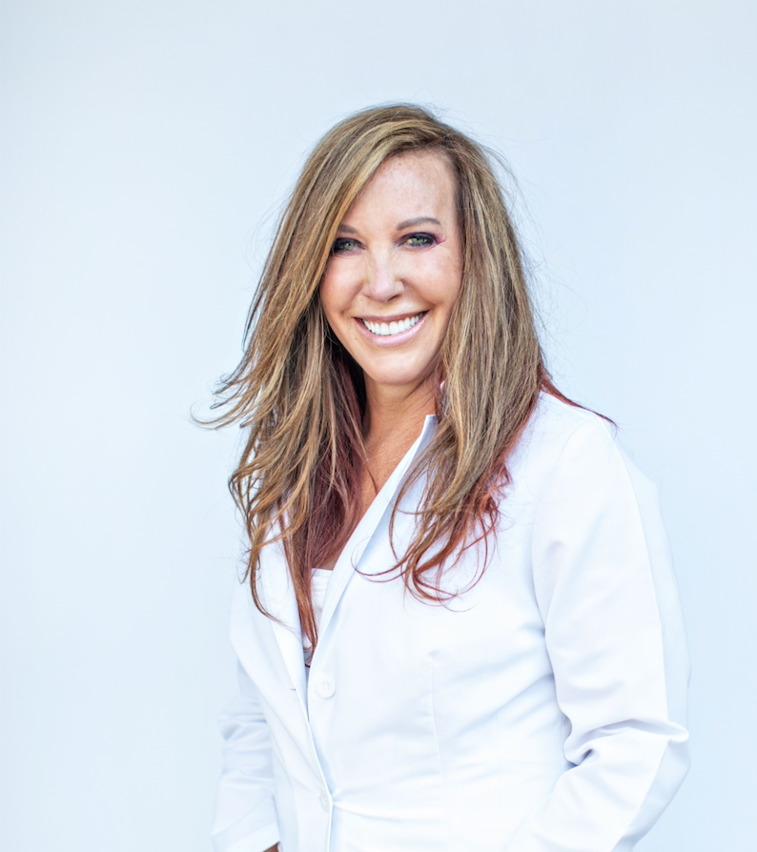
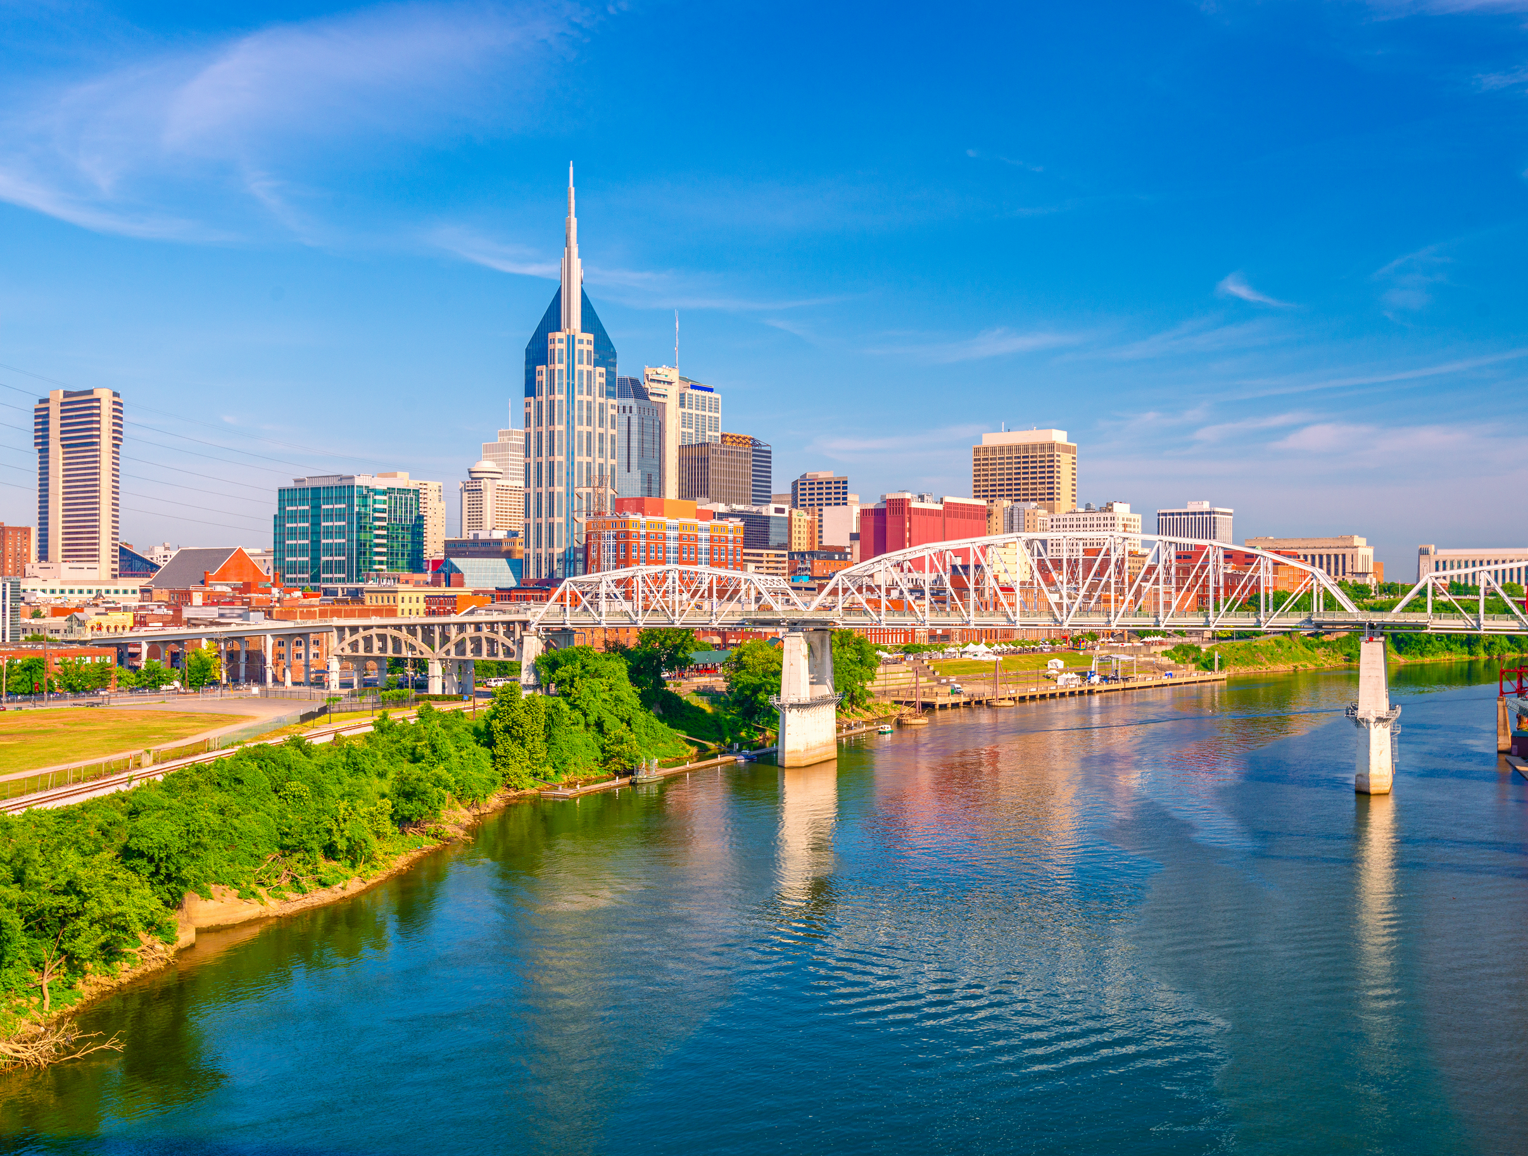
Dr. Christina Rahm Chairman & Founder ISNS

Slide 5
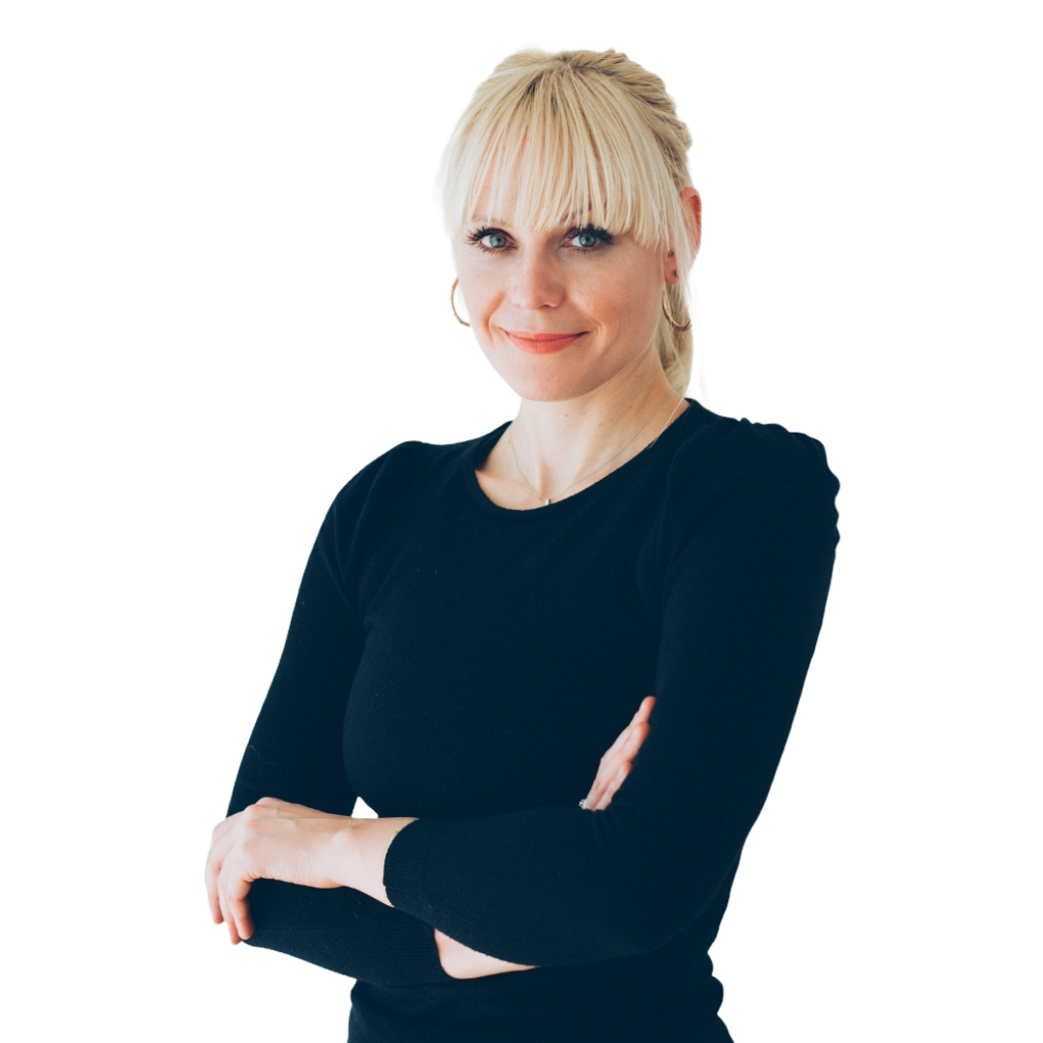
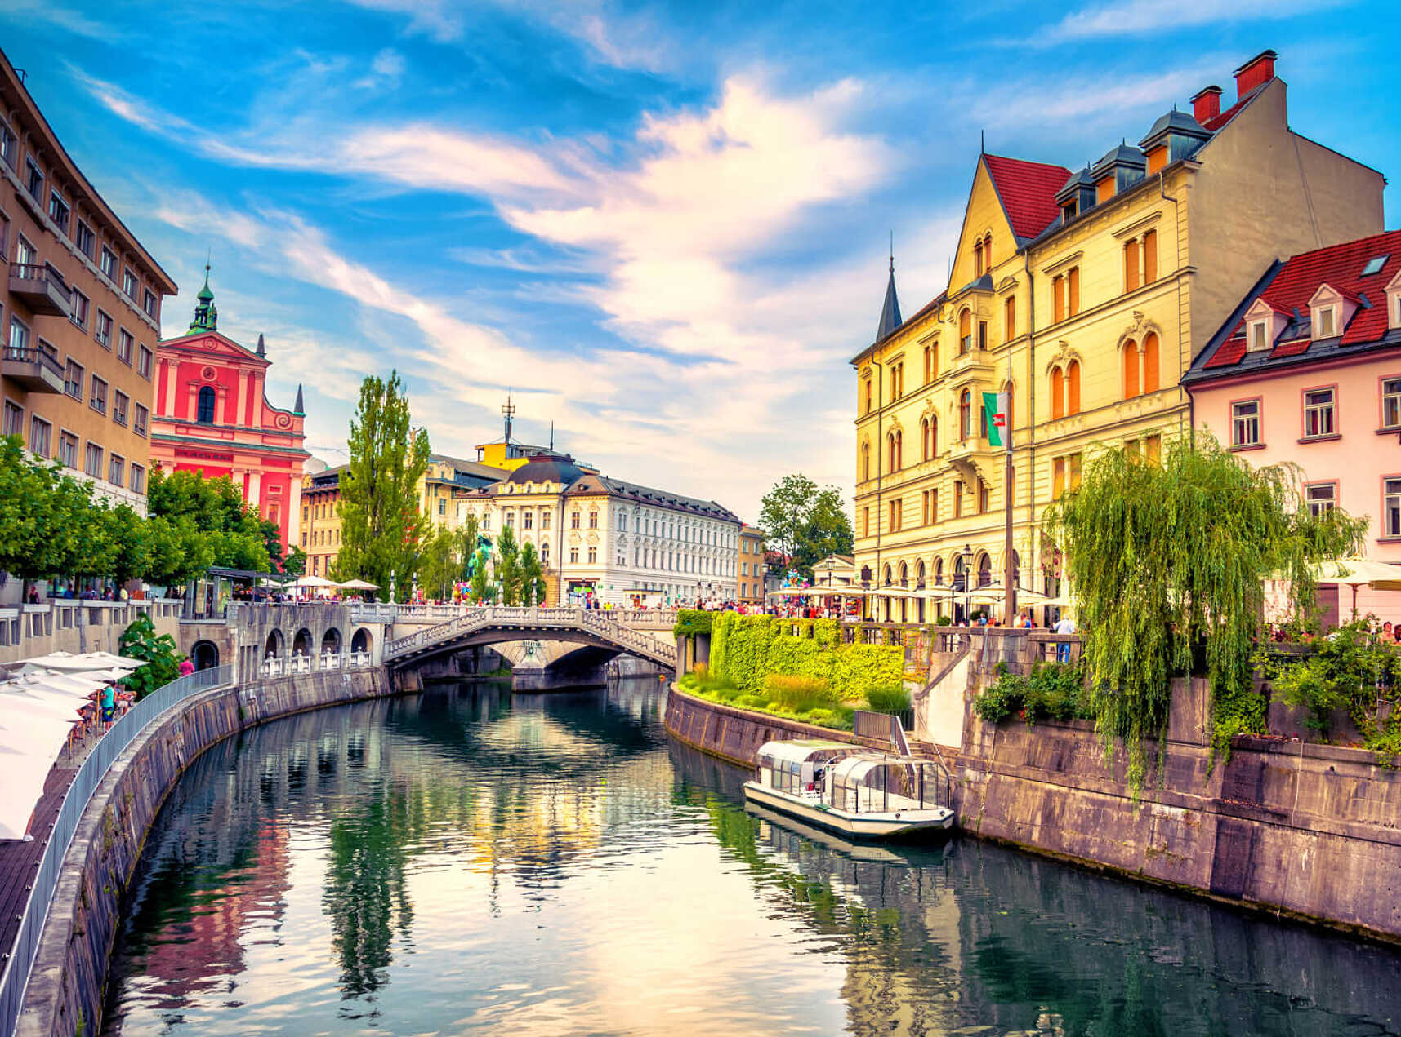
Dr. Tina Božičnik

Slide 6
ISNS Case Study Presented by: Dr. Tina Božičnik

Slide 7
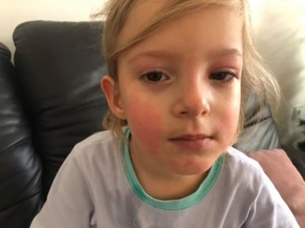
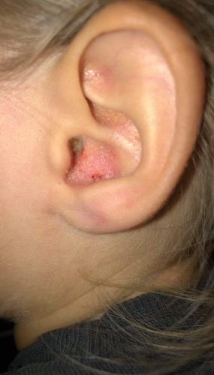
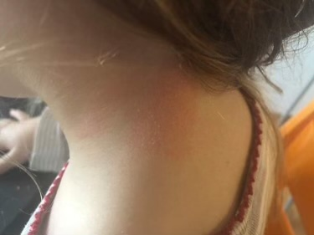
PSORIASIS CHILD
Psoriasis is a common, chronic inflammatory disorder that affects the skin, nails, and joints of ~ 2.0%–3.5% of the general population. Psoriasis begins in childhood in approximately one-third of the cases.
Comorbidities: Children suffering from psoriasis have a higher prevalence of obesity, diabetes mellitus, hypertension, juvenile arthritis, Crohn’s disease (CD), and psychiatric disorders.
Psoriasis in Children:
R Pinson, B Sotoodian, L Fiorillo - Psoriasis (Auckland, NZ), 2016 - ncbi.nlm.nih.gov
International Science and Nutrition Society – CURARE CAUSAM – ISNS 2021

Slide 8
PSORIASIS CHILD
Presentation of skin lesions in 4-year old girl a few months before the scalp lesions appeared.
Eczema?
There is a widespread belief that psoriasis (Ps) and atopic dermatitis (AD) are clinically mutually exclusive. A prospective study was undertaken to record the concurrent and/or consecutive coincidence of the two conditions and any shared clinical features. Patients attending a dermatology clinic were systematically examined for the presence of Ps and/or AD. Nine hundred and eighty-three patients were studied – 428 with Ps, 224 with AD, 45 with both Ps and AD, and 286 controls. Of AD patients 16.7% had Ps, and 9.5% of Ps patients had AD. In consecutive occurrences, Ps generally followed AD. The ratio of concurrent to consecutive incidences was 3:1. The two diseases are shown not to be mutually exclusive and may coexist in the same individual.
Dermatology 1992;184:265–270
Concomitance of Psoriasis and Atopic Dermatitis Beer W.E., Smith A.E., Kassab J.Y., Smith P.H.S. et al.
International Science and Nutrition Society – CURARE CAUSAM – ISNS 2021

Slide 9
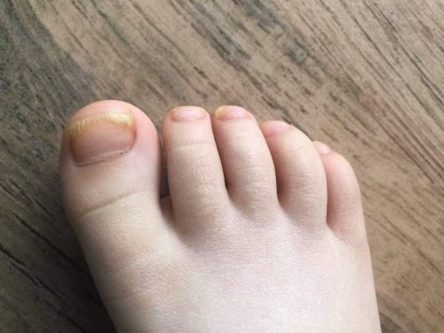
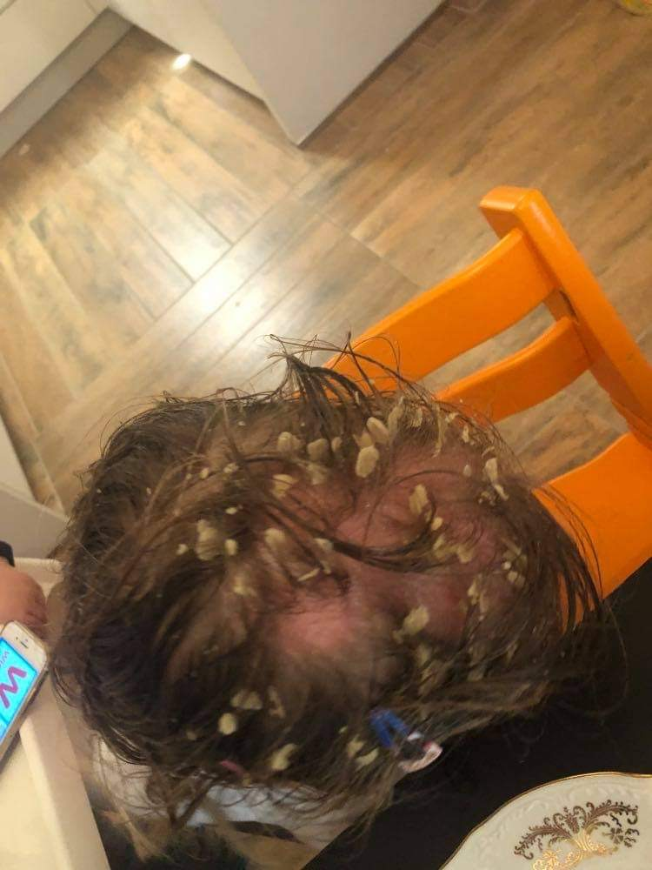
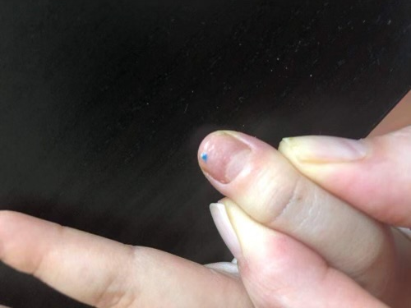
PSORIASIS CHILD
April 2021
4-year old girl was treated for fungal infection on her scalp. During the treatment her dermatologist performed additional tests because of high suspicion of scalp psoriasis, due to red patches of skin covered with thick silvery scales, positioned on her scalp, later progressed to scalp alopecia. Her initial treatment included topical corticosteroids, used for 5 days only, with no significant changes on the skin and terbinafin topically for treatment of suspected fungal infection - used only for a few days.
International Science and Nutrition Society – CURARE CAUSAM – ISNS 2021

Slide 10
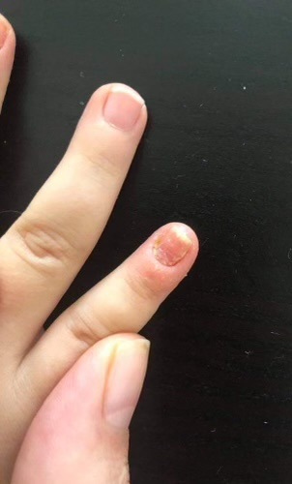
PSORIASIS CHILD
Some skin lesions were also visible on her trunk. The nails showed pitting of the nail surface on her hands and yellow discoloration along with pitting surface on her toe nails. Her stool was never very soft and a lot of times small bleeding was visible on the toilet paper, however her mother never reported a true constipation happening. The skin around the nails was peeling off.
International Science and Nutrition Society – CURARE CAUSAM – ISNS 2021

Slide 11
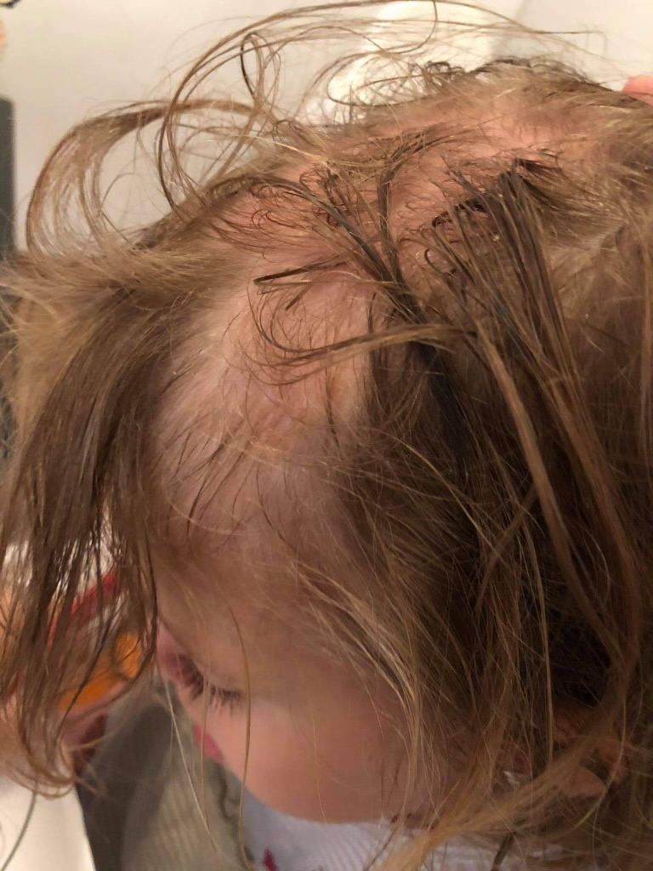
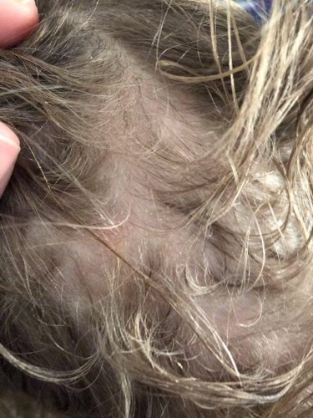
PSORIASIS CHILD
The scalp surface affected, visible hair loss - alopecia areata.
(April 2021) She started a personalized functional medicine protocol for leaky gut and inflammation healing. Part of her leaky gut treatment also included silica, Vitamin C and trace minerals (Clean Slate) in proprietary formula. She started with 2 drops BID diluted in some water, but also topically applied directly to the affected skin. Every week she increased the number for 1 drop, to maximum of 10 drops BID taken orally.
International Science and Nutrition Society – CURARE CAUSAM – ISNS 2021

Slide 12
PSORIASIS CHILD
May 2021
One month after initiating the silica treatment the lesions on her trunk completely disappeared, her nails remained unchanged. Her skin on the scalp still had silvery scales, but no signs of redness and active, inflamed lesions any more. Blood present on the toilet paper after defecation wasn’t visible anymore and never reappeared. She continued all the functional medicine (natural) anti-inflammatory body support treatments.
International Science and Nutrition Society – CURARE CAUSAM – ISNS 2021

Slide 13
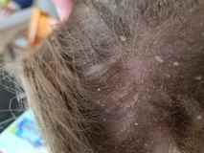
PSORIASIS CHILD
June 2021
After the first month of treatment the skin wasn’t showing any signs of active inflammation anymore, but it was still covered with silvery scales, regularly removed by her mother. The skin around her nails stopped exfoliating and stopped peeling off completely. The nails still showed pitting.
International Science and Nutrition Society – CURARE CAUSAM – ISNS 2021

Slide 14
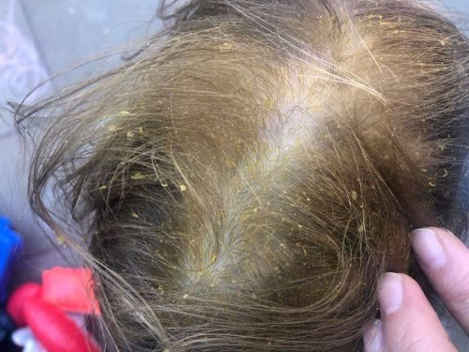
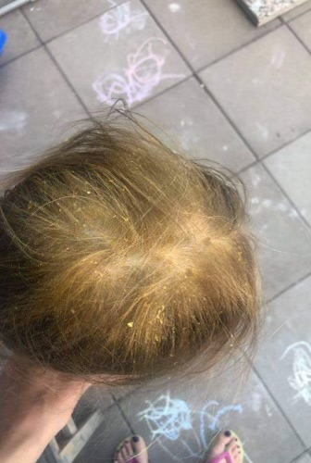
PSORIASIS CHILD
June/July 2021
After 3 months her mother reported less silvery scales, the skin wasn’t red anymore, the nails on her toes were of normal color and had no unevenness on the surface. On her hand nails some pitting was still present.
(Restore): Proprietary formula that included Turmeric, Resveratrol, Black Cumin Seed, Raspberry ketone, D-Ribose and Aloe Vera was introduced, she was taking 2 tea spoons daily and applied it regularly on the slap skin. We gradually increased the daily intake, tailoring treatment specific according to the reactions of her body.
International Science and Nutrition Society – CURARE CAUSAM – ISNS 2021

Slide 15
PSORIASIS CHILD
5th month of treatment: (2nd month on (Restore) Proprietary formula that included Turmeric, Resveratrol, Black Cumin, Seed Aloe Vera, Raspberry Ketone was started, first signs of hair growth, practically no silvery scales were visible any more. The skin on the trunk and on the scalp was still devoid of active/new lesions. The toe nails remained healthy, there was a significant reduction of pitting of the nails of the hands. On her nails and scalp skin we added topical treatments for her call and nails based on active oxygen, panthenol, colloidal silver and ozoile cream.
International Science and Nutrition Society – CURARE CAUSAM – ISNS 2021

Slide 16
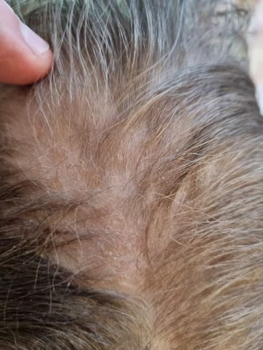
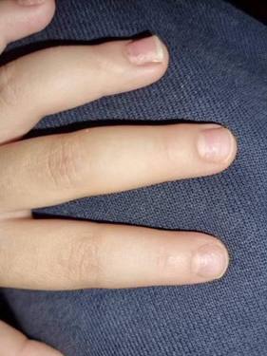
International Science and Nutrition Society – CURARE CAUSAM – ISNS 2021

Slide 17
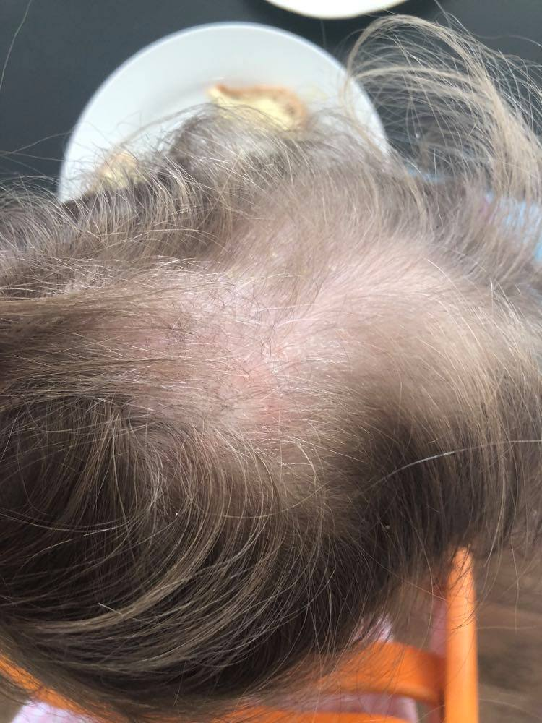
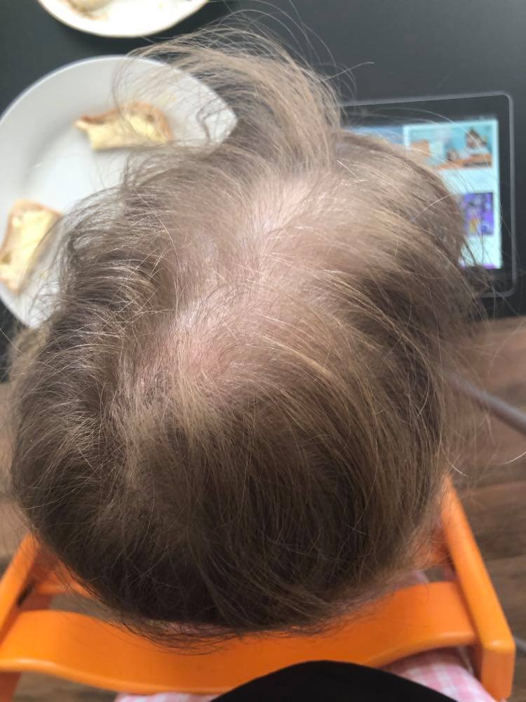
International Science and Nutrition Society – CURARE CAUSAM – ISNS 2021

Slide 18
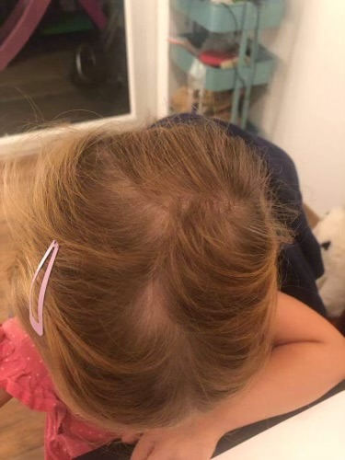
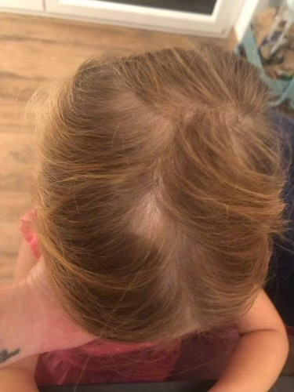
PSORIASIS CHILD
August 2021
Skin on the scalp was without scales, no signs of inflammation on the skin of her trunk or elsewhere. The toe nails remain intact, marked reduction of hand nails pitting, ring finger on her right hand still showing some pitting, the rest of the fingers almost nothing. Marked hair re-growth alopecia almost invisible at this point.
International Science and Nutrition Society – CURARE CAUSAM – ISNS 2021

Slide 19
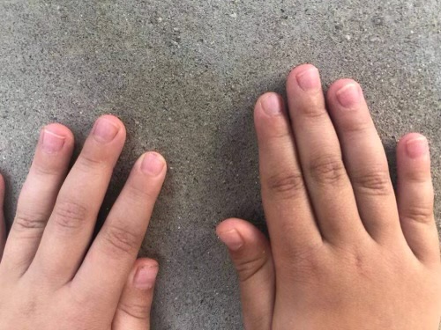
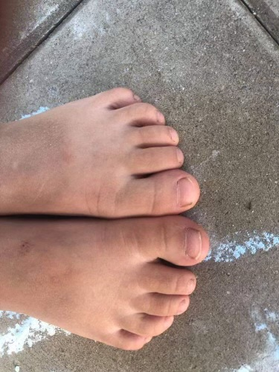
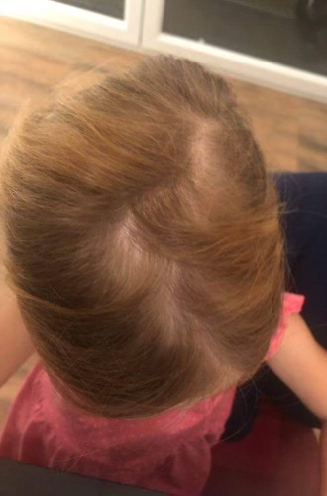
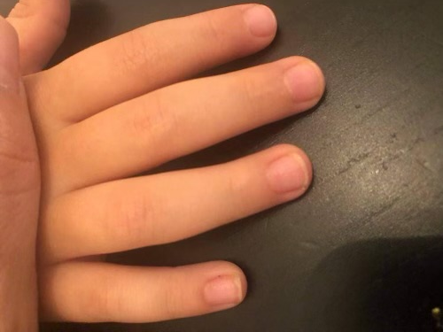
International Science and Nutrition Society – CURARE CAUSAM – ISNS 2021

Slide 20
Through the progression of the treatment she was given, along with personalized leaky gut healing protocol, 10 drops BID of silica in proprietary formula (Clean Slate) and 2 TS of Proprietary formula that included Turmeric, Resveratrol, Black Cumin Seed, Aloe Vera, R-ribose and Raspberry ketone (Restore), 1 TS in the morning and one in the afternoon. She is still using topical treatment with Active oxygen gel with aloe vera and colloidal silver for her skin and the nails, as well as the Ozoile cream.
The plan is to continue that until we get the full restoration of the hair and then we will tailor the plan according to the signs still present. (September 2021)
International Science and Nutrition Society – CURARE CAUSAM – ISNS 2021

Slide 21
International Science and Nutrition Society – CURARE CAUSAM – ISNS 2021

Slide 22
September 2021 - January 2022
International Science and Nutrition Society – CURARE CAUSAM – ISNS 2021

Slide 23
September 2021
International Science and Nutrition Society – CURARE CAUSAM – ISNS 2021

Slide 24
International Science and Nutrition Society – CURARE CAUSAM – ISNS 2021

Slide 25
January 2022
International Science and Nutrition Society – CURARE CAUSAM – ISNS 2021

Slide 26
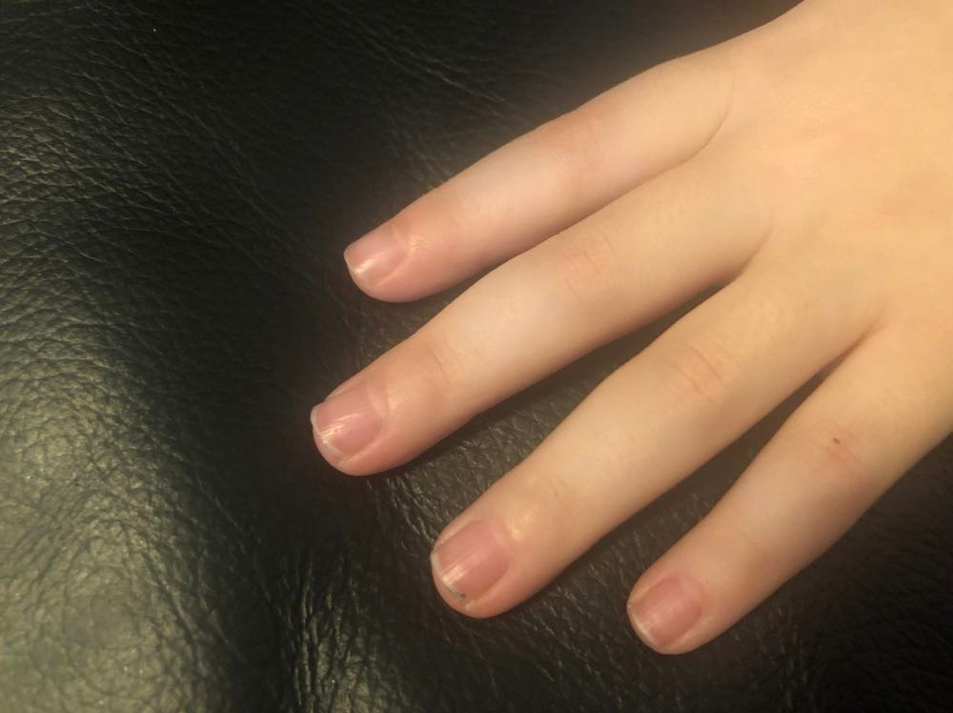
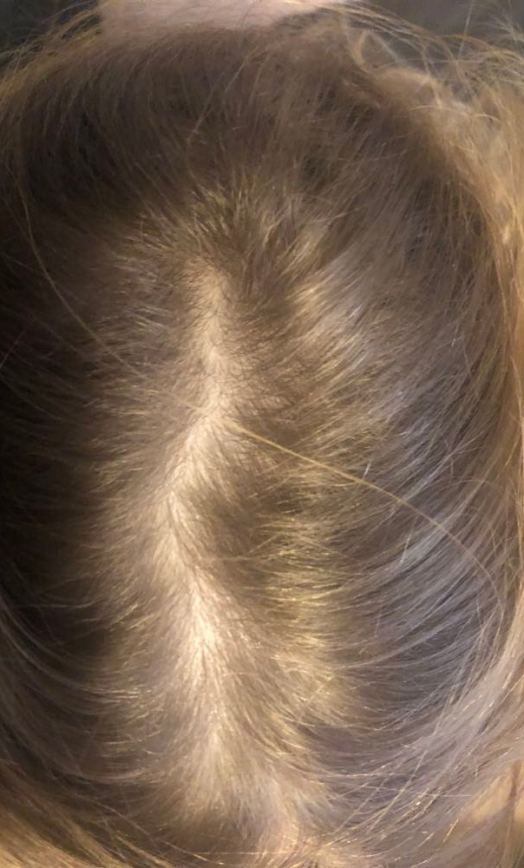
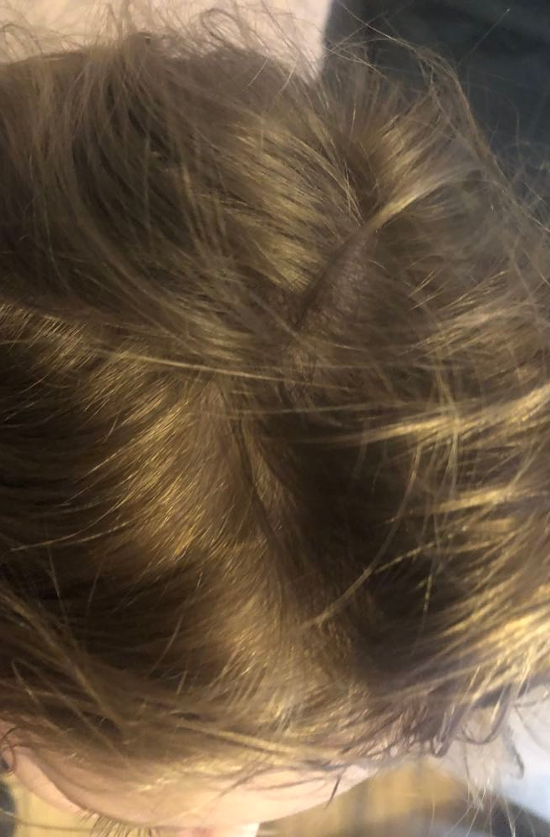
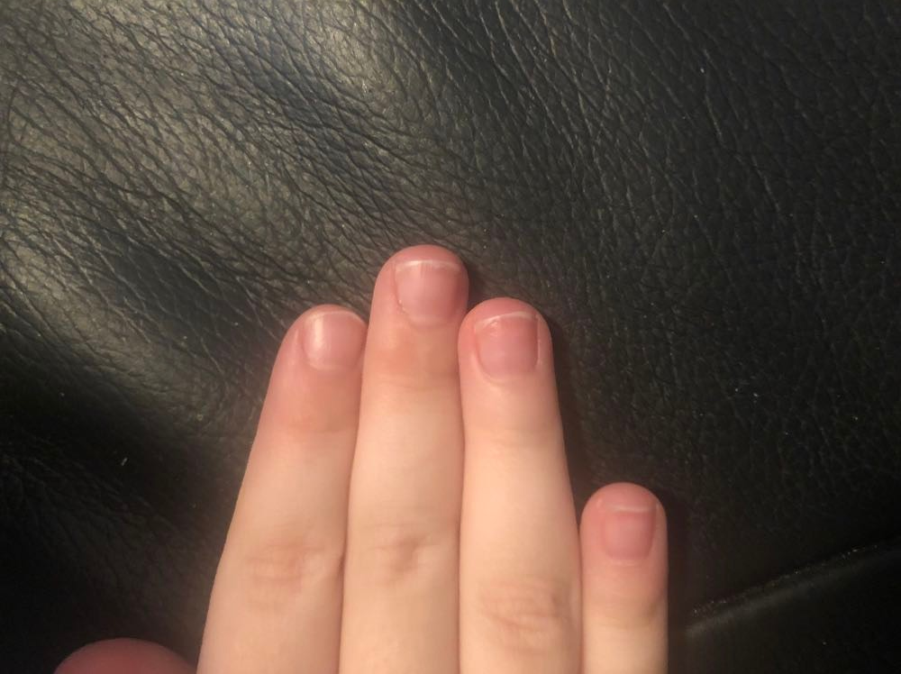
International Science and Nutrition Society – CURARE CAUSAM – ISNS 2021

Slide 27
Comparison Sept 2021 - January 2022
International Science and Nutrition Society – CURARE CAUSAM – ISNS 2021

Slide 28
International Science and Nutrition Society – CURARE CAUSAM – ISNS 2021

Slide 29
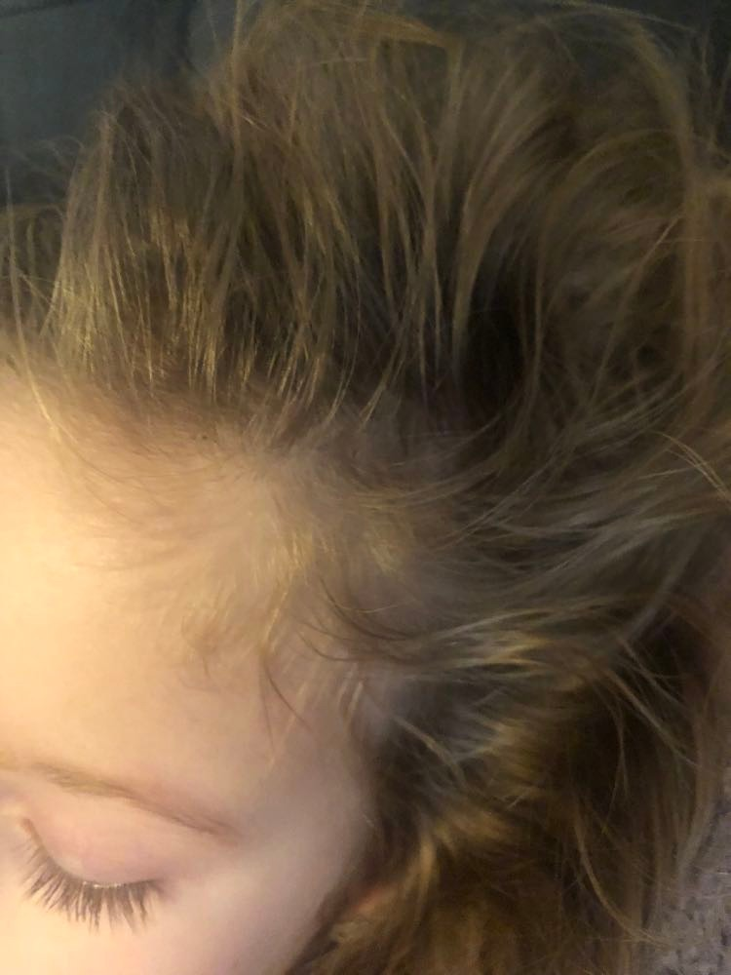
April 2021 - January 2022
International Science and Nutrition Society – CURARE CAUSAM – ISNS 2021

Slide 30
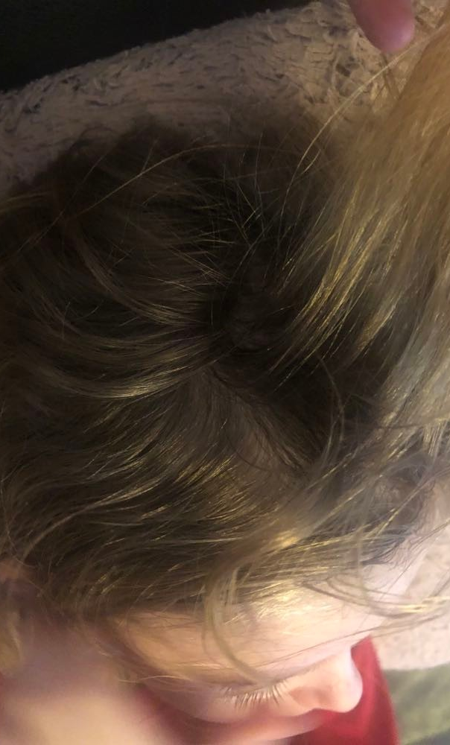
International Science and Nutrition Society – CURARE CAUSAM – ISNS 2021

Slide 31
International Science and Nutrition Society – CURARE CAUSAM – ISNS 2021

Slide 32
Nail comparison April 2021- January 2022
International Science and Nutrition Society – CURARE CAUSAM – ISNS 2021

Slide 33
International Science and Nutrition Society – CURARE CAUSAM – ISNS 2021

Slide 34
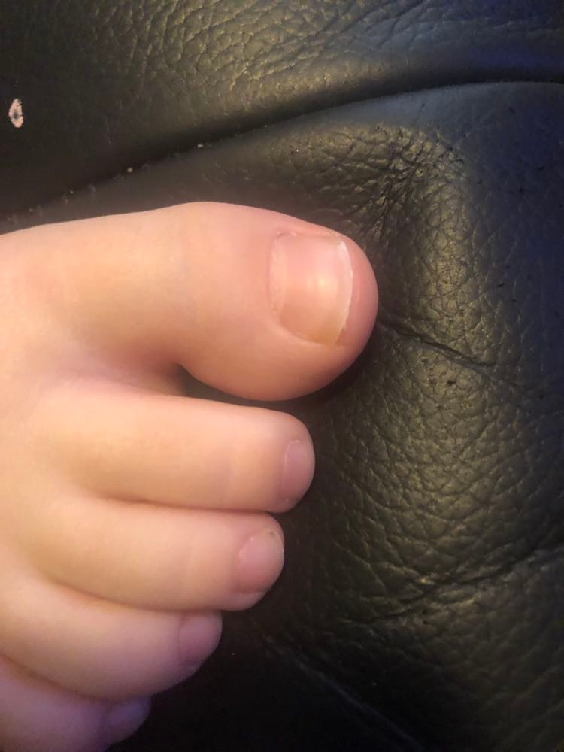
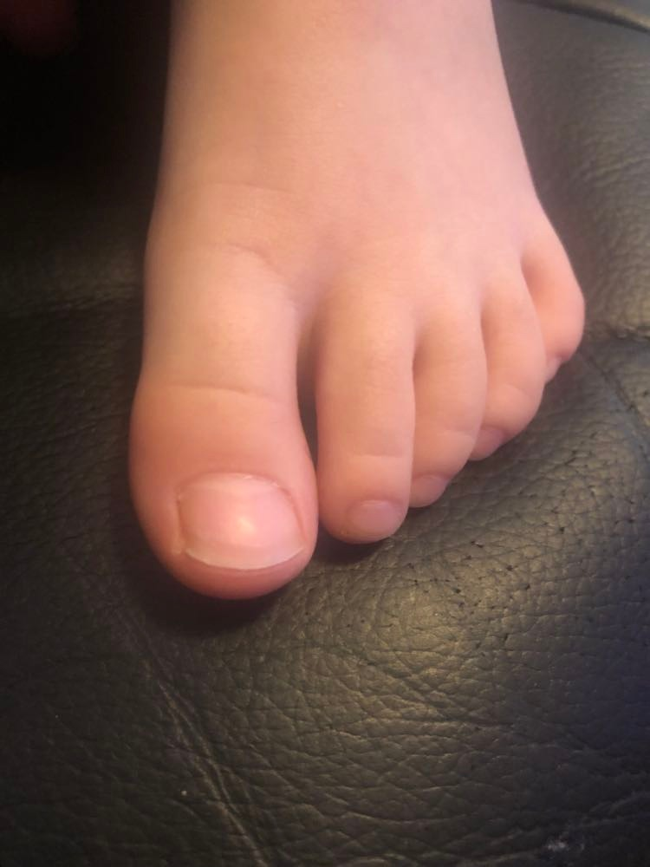
International Science and Nutrition Society – CURARE CAUSAM – ISNS 2021

Slide 35
International Science and Nutrition Society – CURARE CAUSAM – ISNS 2021

Slide 36
In April 2021 we started the holistic treatment working to lower the inflammation on all levels, through the progression of the treatment with personalized leaky gut healing protocol and immune balancing using other personalized supplements, among others she took 10 drops BID of silica in proprietary formula (Clean Slate) and 2 TS of Proprietary formula that included Turmeric, Resveratrol, Black Cumin Seed, Aloe Vera, R-ribose and Raspberry ketone (Restore), 1 TS in the morning and one in the afternoon - from the beginning up until now. She is still using topical treatment with Active oxygen gel with aloe vera and colloidal silver for her skin and the nails, as well as the Ozoile cream. We closely monitored the reactions of the body and adjusted the treatment accordingly.
Right now she is off all the topicals and remained only on Proprietary blend I (Clean Slate) and Proprietary blend III Restore, dosage as mentioned above for another four months, after that we will re-check and replan the maintenance doses for the future.
International Science and Nutrition Society – CURARE CAUSAM – ISNS 2021

Slide 37
Use of Curcumin in Psoriasis Veronica Di Nardo, Serena Gianfaldoni, Georgi Tchernev, Uwe Wollina, Victoria Barygina, Jacopo Lotti,1 Farah Daaboul, and Torello Lotti
The use of curcumin at 25 and 50 µM concentrations in the treatment of psoriatic - like cells (HaCaT cells), in vitro, were investigated. The study found that curcumin was able to inhibit the proliferation of psoriatic-like cells, by down-regulation of pro-inflammatory cytokines
A study on mice models consisting in the inhibition of the potassium channels expressed on T cells, which are involves in the onset of psoriasis, was conducted. The results showed that in their serum there was a decrease of more than 50% level of inflammatory factors, such as TNF - α, IFN - γ, IL - 2, IL - 12, IL - 22 and IL – 23
https://www.ncbi.nlm.nih.gov/labs/pmc/articles/PMC5816303/
International Science and Nutrition Society – CURARE CAUSAM – ISNS 2021

Slide 38
Antipsoriatic activity and cytotoxicity of ethanolic extract of Nigella sativa seeds Lalitha Priyanka Dwarampudi , Dhanabal Palaniswamy, Muruganantham Nithyanantham, P S Raghu
The ethanolic extract of Nigella sativa seeds were evaluated for antipsoriatic activity. The results found that Nigella sativa seeds produced a significant epidermal differentiation. The 95% ethanolic extract of Nigella sativa shown IC50 239 μg/ml, with good antiproliferant activity. The ethanolic extract of Nigella sativa seeds also showed increase in relative epidermal thickness when compared to control group
https://pubmed.ncbi.nlm.nih.gov/24082629/
International Science and Nutrition Society – CURARE CAUSAM – ISNS 2021

Slide 39
Trace Elements Homeostatic imbalance in Mild and Severe Psoriasis: A New Insight In Biomarker Diagnostic Value For Psoriasis Nagat Sobhy Mohamad
To evaluate the possible role of trace elements in mild and severe psoriasis. Sixty patients suffering from psoriasis were included in the study and 30 healthy subject served as a control. Serum sample analysis for some trace elements namely Na, K, Ca, P, Cu, Zn, and Fe using inductively coupled plasma-atomic emission spectroscopy (ICP-AES). In psoriatic patients, the level of serum calcium and zinc were decreased while the level of serum copper, iron and organic phosphorous were increased.
https://pdfs.semanticscholar.org/d4b6/db08498b6279f4fe62930c1d758cd0144b16.pdf
International Science and Nutrition Society – CURARE CAUSAM – ISNS 2021

Slide 40
Bioactive molecules from the Blue Lagoon: in vitro and in vivo assessment of silica mud and microalgae extracts for their effects on skin barrier function and prevention of skin ageing Susanne Grether-Beck, Kathrin Mühlberg, Heidi Brenden, Ingo Felsner, Ása Brynjólfsdóttir, Sigurbjörn Einarsson, and Jean Krutmann
Researchers reported that silica mud is capable of reducing involucrin, loricrin, transglutaminase-1 and filaggrin gene expression in primary human epidermal keratinocytes. It was also found to affect primary human dermal fibroblasts and induced collagen 1A1 and 1A2 gene expression in this cell type. These findings suggest silica’s potential to improve skin barrier function.
https://onlinelibrary.wiley.com/doi/abs/10.1111/j.1600-0625.2007.00693.x
International Science and Nutrition Society – CURARE CAUSAM – ISNS 2021

Slide 41
References
https://www.ncbi.nlm.nih.gov/labs/pmc/articles/PMC5816303/
https://pubmed.ncbi.nlm.nih.gov/24082629/
https://pdfs.semanticscholar.org/d4b6/db08498b6279f4fe62930c1d758cd0144b16.pdf
https://www.psoriasis.org/psoriasis-statistics/
https://pubmed.ncbi.nlm.nih.gov/17658397/.
https://www.msdmanuals.com/professional/dermatologic-disorders/psoriasis-and-scaling-diseases/psoriasis
https://onlinelibrary.wiley.com/doi/abs/10.1111/j.1600-0625.2007.00693.x
International Science and Nutrition Society – CURARE CAUSAM – ISNS 2021

Slide 42
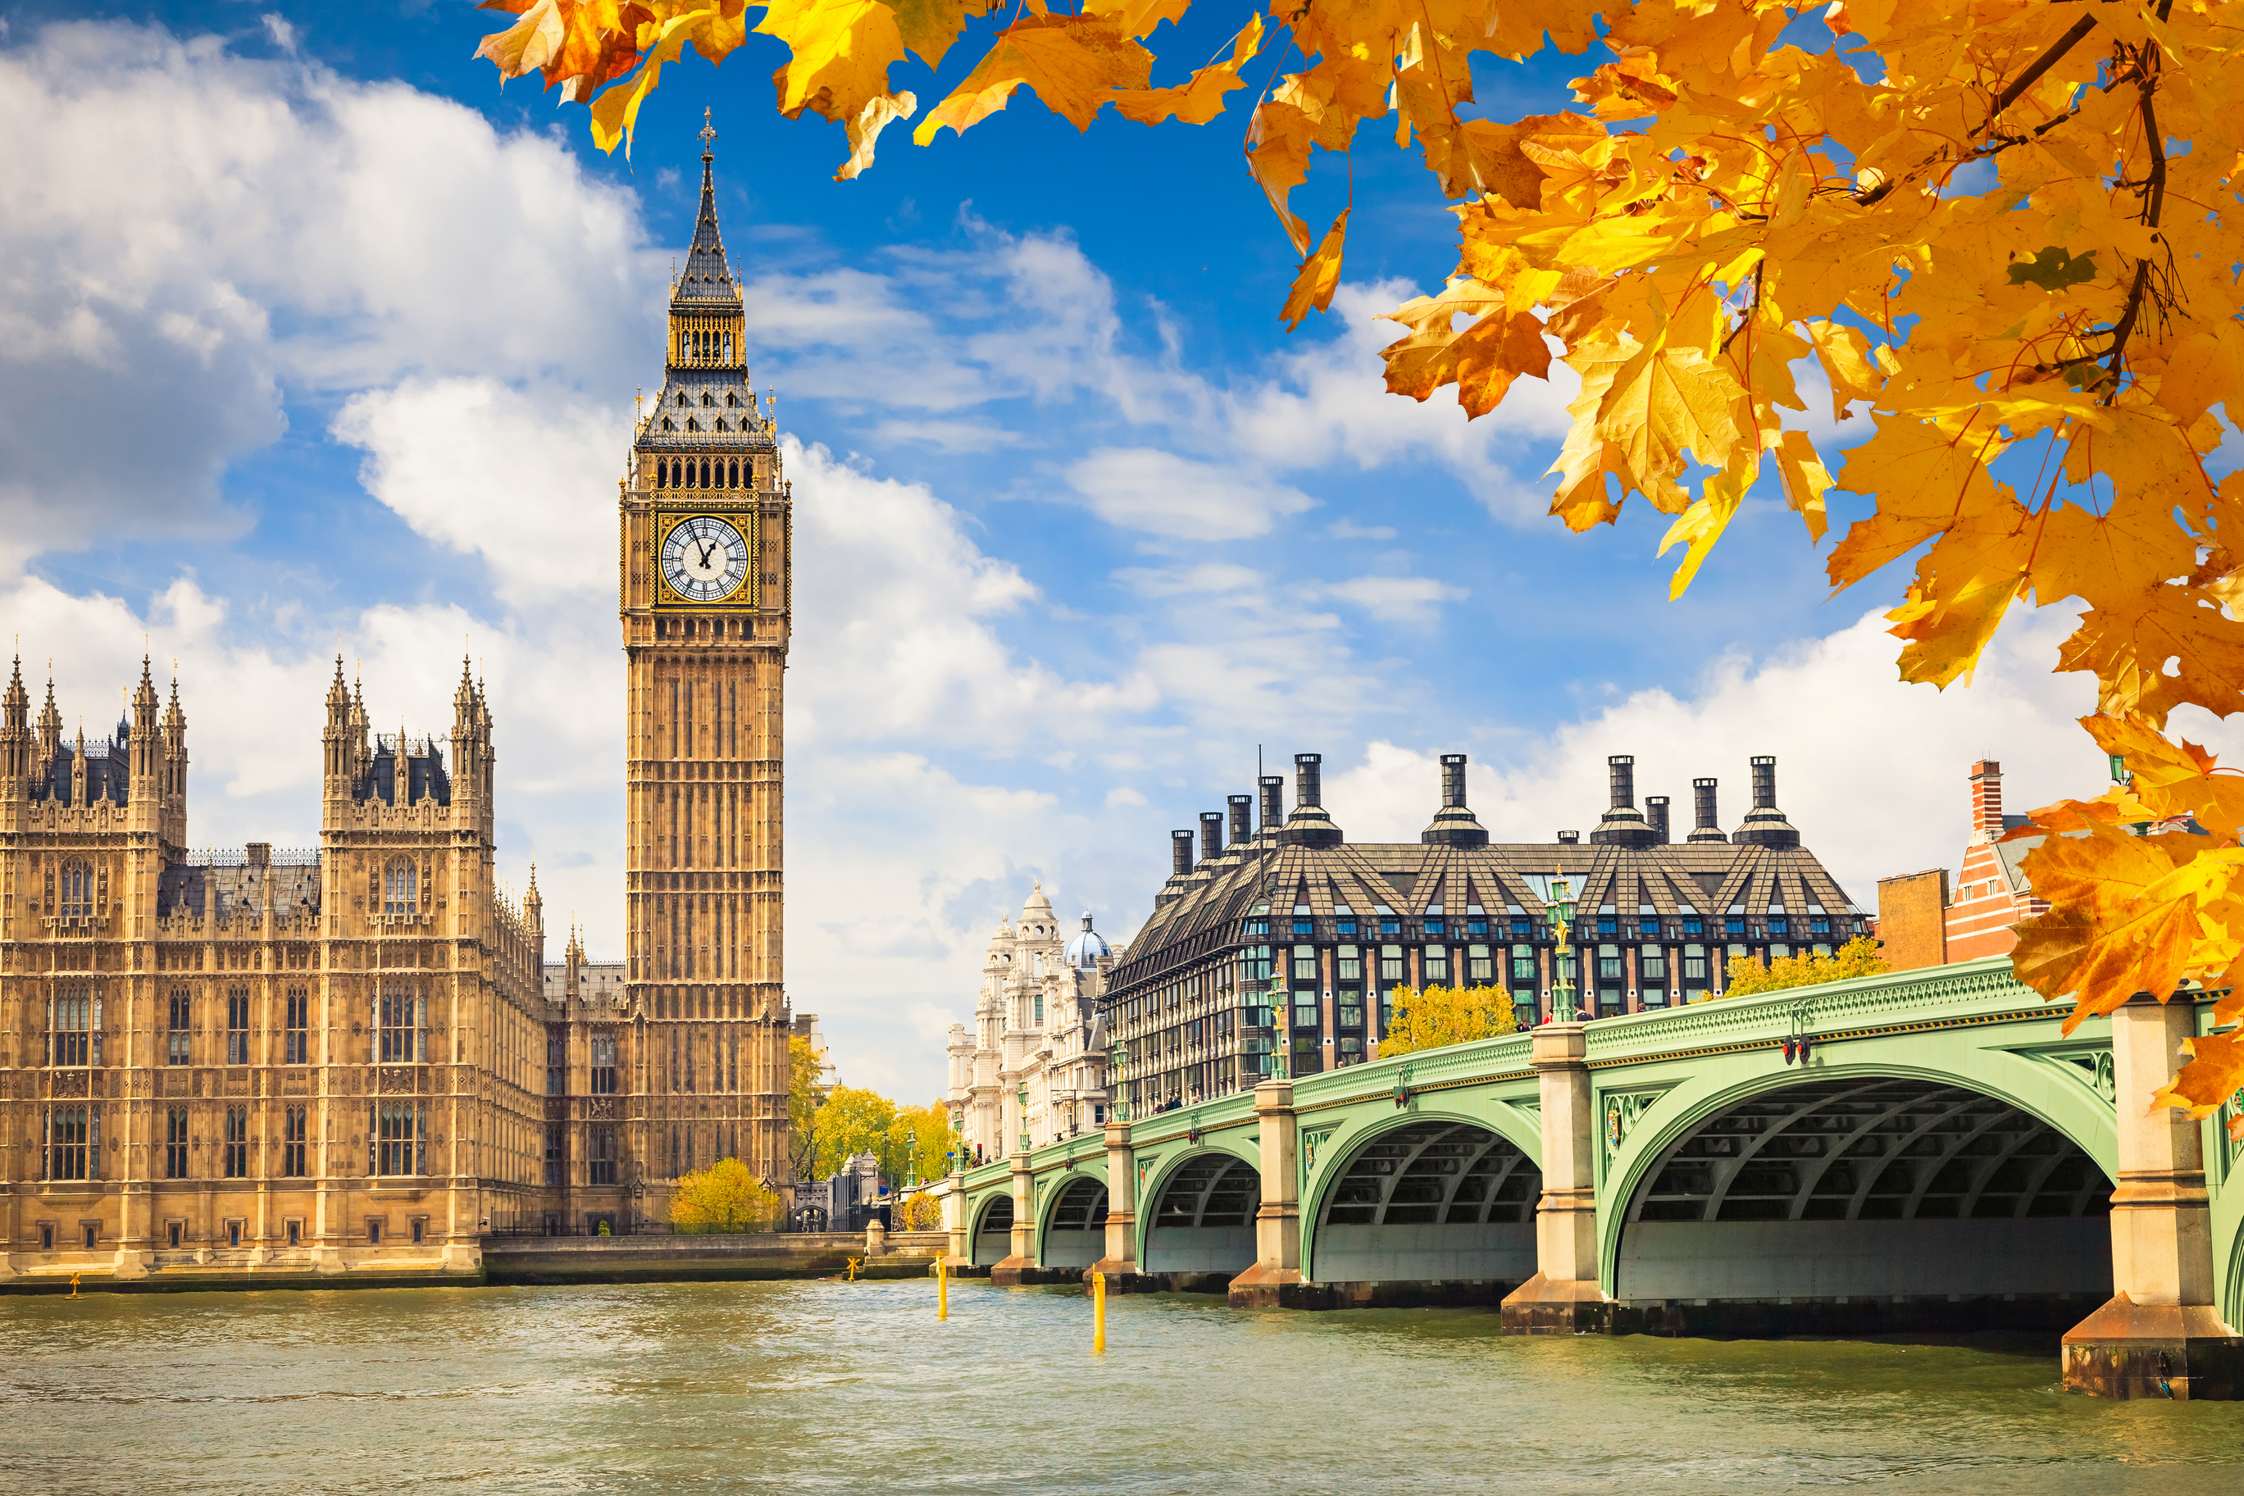
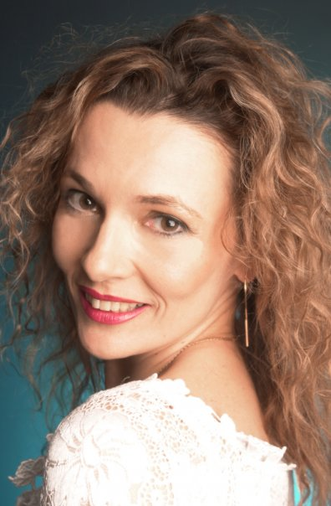
Clare G. Harvey

Slide 43
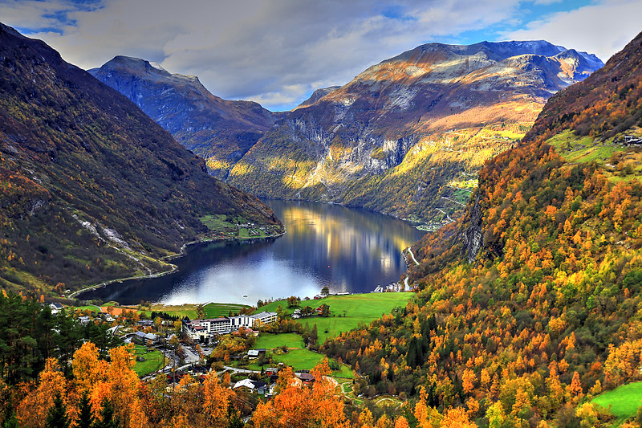
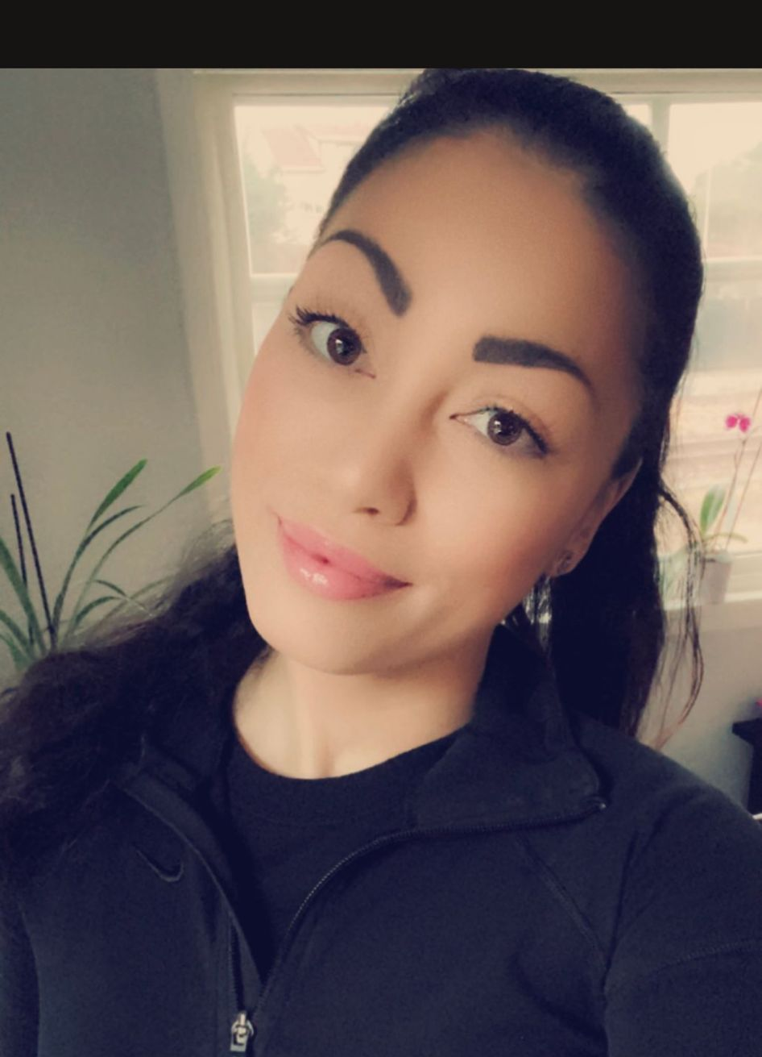
Kirsten G. Nærbø

Slide 44
THANK YOU FOR JOINING US TODAY!

